Slide 1
CPSC 483 Ensemble Learning
Anand Panangadan
apanangadan@fullerton.edu

Slide 2
What we will cover this week
Voting classifiers
Bagging
Random forests
Boosting
Stacking

Slide 3
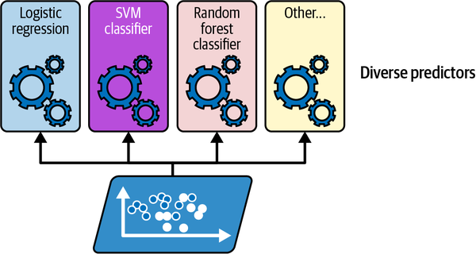
Voting classifiers
Core idea
Train multiple classifiers on the same data

Slide 4
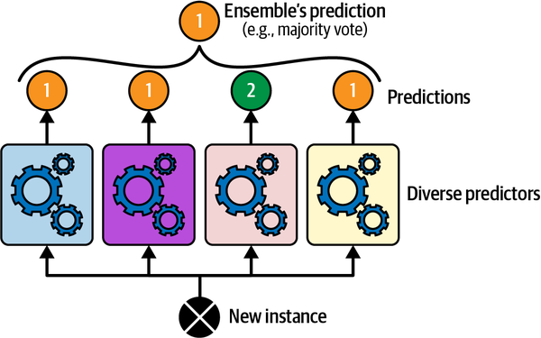
Voting classifiers
A simple way to create a better classifier:
aggregate the predictions of each classifier
Class that gets the most votes is the final prediction.
This majority-vote classifier is called a hard voting classifier

Slide 5
Ensemble classification
weak learner: a classifier that is only slightly better than random guessing
Strong learner: a classifier with high accuracy
An ensemble of weak learners can be a strong learner, provided
there are a sufficient number of weak learners
and they are sufficiently diverse

Slide 6
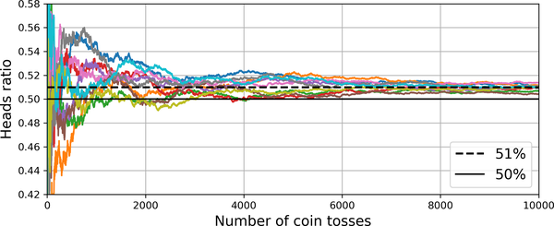
Ensemble classification intuition
Given a slightly biased coin (51-49%), how to identify which side (head/tail) is biased?
Guess after one toss: likely to be wrong 49%
Guess after 1000 tosses: likely to be wrong only 25%

Slide 7
Soft voting
If all classifiers can also output a class probabilities
soft voting: output the class with the highest average probability
often achieves higher performance than hard voting because it gives more weight to highly confident votes

Slide 8
Bagging
How to get a diverse set of classifiers?
use different training algorithms:
Decision trees
Support Vector machines
Logistic regression
…
Another approach:
Use one training algorithm but train them on different random subsets of the data
bagging (bootstrap aggregating)

Slide 9
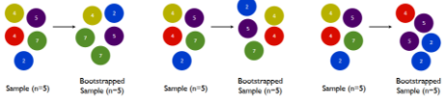
Bootstrap Sampling
Given a sample data D containing N examples, create a subset D_{i}, by drawing n examples at random with replacement from D.
Some samples may be repeated in each D_{i}.
E.g., D={1,2,3}, bootstrapped samples D₁={1,1,2}, D₂={1,2,3}, D₃={1,3,3}
It is a type of resampling method.
An empirical bootstrap sample is drawn from observations.
A parametric bootstrap sample is drawn from a parameterized distribution (e.g., a normal distribution).

Slide 10
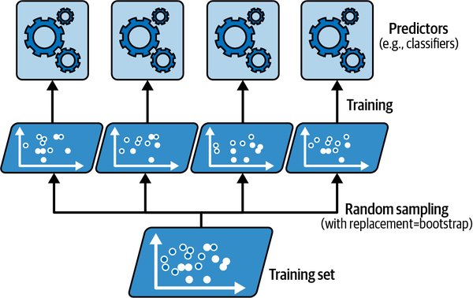
Bagging
After training, the ensemble can make a prediction for a new instance by aggregating the predictions of all predictors
Majority vote for classification (mode)
Average for regression (mean)
Aggregation reduces variance
The ensemble has a similar bias but a lower variance than a single predictor trained on the original training set.

Slide 11
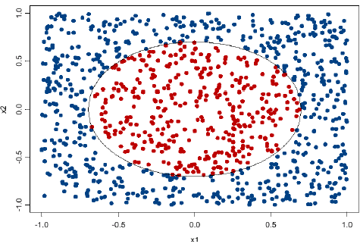
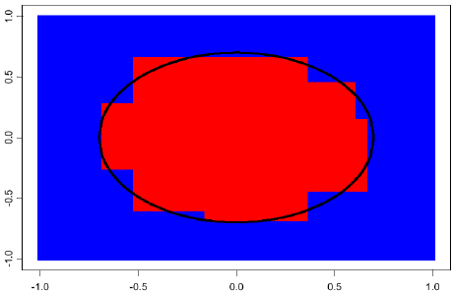
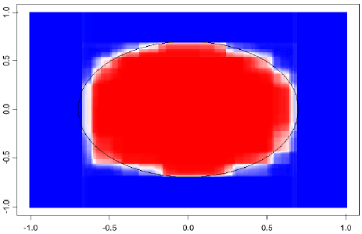
Examples of Bagging
Shades of blue/red indicate strength of vote for particular classification.

Slide 12
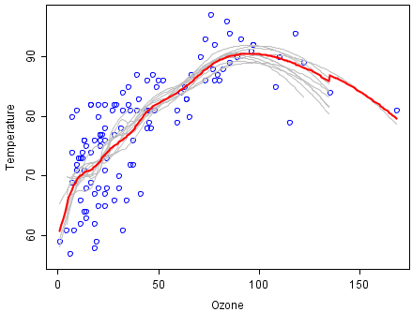
Examples of Bagging
An analysis on the relationship between ozone and temperature (Rousseeuw and Leroy, 1986)
100 bootstrap samples of the data were drawn. Predictions from these 100 smoothers were then made across the range of the data.
By taking the average of 100 smoothers, each fitted to a subset of the original data set, one bagged predictor (red line) is created.
Clearly, the mean is more stable and there is less overfit.

Slide 13
Random Forests

Slide 14
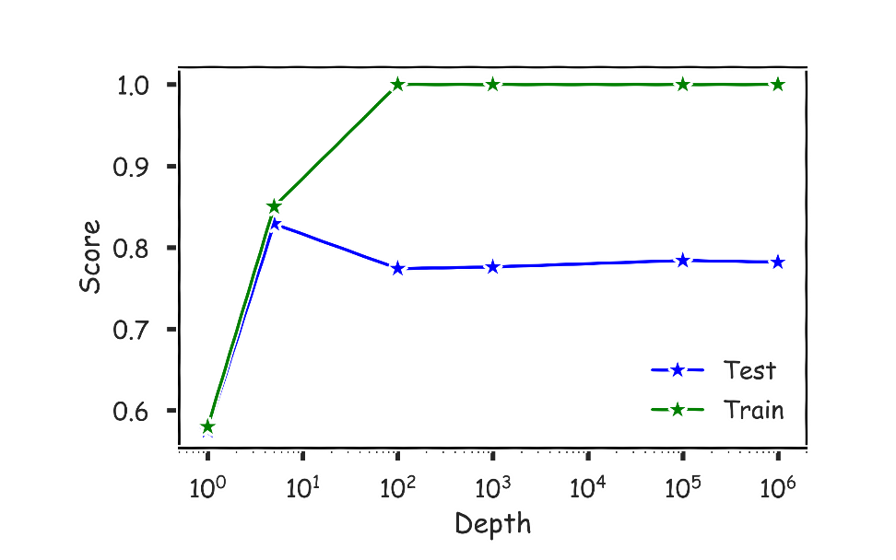
Limitations of Decision Tree Models
Decision trees models are highly interpretable and fast to train
using the greedy ID3/CART learning algorithms.
However, to capture a complex decision boundary, we need to build a large tree
Each node can only make axis aligned splits
Large trees have high variance and are prone to overfitting.
In practice, decision tree models often underperforms when compared with other classification or regression methods.

Slide 15
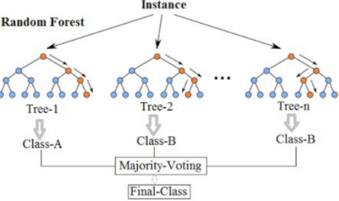
Random Forests (used in CART)
D
D₁
D₂
D_{k}
An ensemble method specifically
designed for decision tree classifiers
Training algorithm
Draw K bootstrap samples,
Grow a tree from each sample (creating random forests),
Select m attributes randomly, pick the best attribute, select a split-point of the attribute, and split the node.
The best attribute by Gini index for classification, MSE for regression
Return the ensemble of trees.
Prediction for a new instance: return the majority or average the predictions of the trees

Slide 16
Random forests
Two sources of randomness
Bagging: each tree is grown using a bootstrap sample of training data.
Random attributes: at each node, best split is chosen from a random sample of m attributes
instead of all attributes.

Slide 17
Tuning Random Forests
Random forest models have multiple hyper-parameters to tune:
the number of predictors to randomly select at each split
the total number of trees in the ensemble
When the number of predictors is large, but the number of relevant predictors is small, random forests can perform poorly.
In each split, the chances of selected a relevant predictor will be low and hence most trees in the ensemble will be weak models.
the minimum leaf node size
In theory, each tree in the random forest can be full, but in practice this can be computationally expensive.

Slide 18
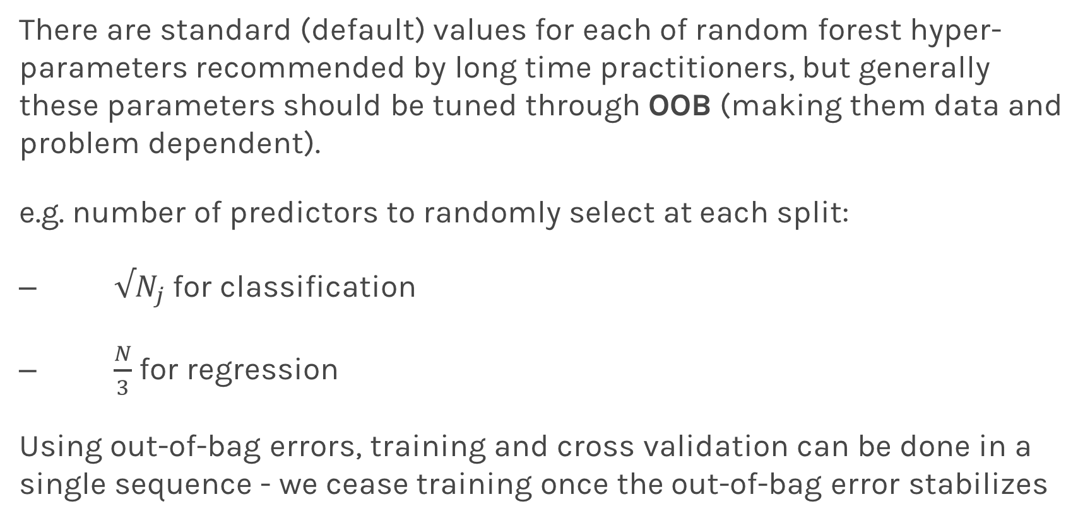
Tuning Random Forests
There are standard (default) values for each of random forest hyper-parameters recommended by long time practitioners, but generally these parameters should be tuned through OOB (making them data and problem dependent).
e.g. number of predictors to randomly select at each split:
$√N_{j}$ for classification
$\frac{N}{3}$ for regression
Using out-of-bag errors, training and cross validation can be done in a single sequence - we cease training once the out-of-bag error stabilizes

Slide 19
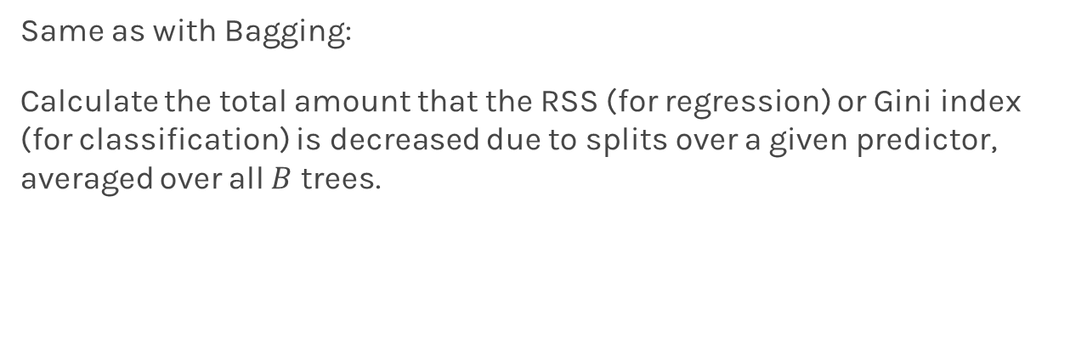
Variable Importance for RF
Same as with Bagging:
Calculate the total amount that the RSS (for regression) or Gini index (for classification) is decreased due to splits over a given predictor, averaged over all $B$ trees.

Slide 20
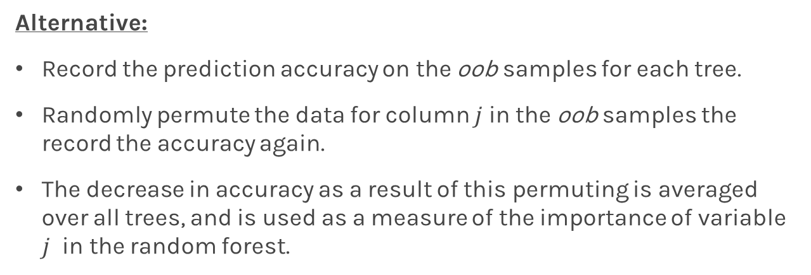
Variable Importance for RF
Alternative:
Record the prediction accuracy on the oob samples for each tree.
Randomly permute the data for column $j$in the oob samples the record the accuracy again.
The decrease in accuracy as a result of this permuting is averaged over all trees, and is used as a measure of the importance of variable $j$ in the random forest.

Slide 21
Pros and Cons of Random Forests
Advantages
Lower variance (less overfitting) compared to a single decision tree
Can process large data sets with higher dimensions.
Each decision tree can be trained in parallel
Can work even when there is missing data
With bootstrap sampling, some of the samples can be used for testing (called the out of bag samples).
Dimensionality reduction by calculating feature importance
Disadvantages
A black box
Easy to follow the logic of a single decision tree
Not so easy when there are hundreds of decision trees
“The major drawback of ensemble methods is that the averaged model is no longer easily interpretable - i.e. one can no longer trace the ‘logic’ of an output through a series of decisions”

Slide 22
Class work
Load the autompg.csv dataset
Use scikit-learn RandomForestClassifier with 100 decision trees to classify Cylinders based on the other features
Drop the last column (model name)
Visualize the decision tree

Slide 23
Textbook code
Textbook code
Textbook code on Google Colab
Open 07_ensemble_learning_and_random_forests.ipynb

Slide 24
Boosting

Slide 25
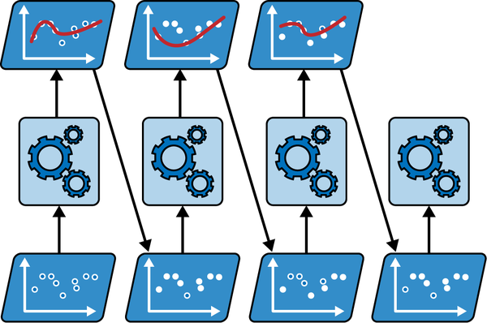
Boosting

Slide 26
Boosting
Train a base classifier (such as a decision tree) and uses it to make predictions on the training set.
Increases the relative weight of misclassified training instances
Train a second classifier, using the updated weights,
Again make predictions on the training set, update the instance weights
Iterate

Slide 27
Acknowledgement
Many slides from Dr. Christopher Ryu
Content based on “Hands-On Machine Learning with Scikit-Learn, Keras, and TensorFlow,” Aurélien Géron, 3rd Edition (October 2022), O'Reilly Media, Inc.
Lecture 16: Regression Trees, Bagging and Random Forest

